Slide 1

Machine comprehension

Slide 2

Machine Comprehension
Chris Burges 2013
Question Answering over Curated and Open Web Sources R. Saha Roy and A. Anand SIGIR 2020 Tutorial
26 July 2020

Slide 3
Problem Setting
context
Canberra
Document or a Passage
Extractive phrase
Sentence
question
answer
What is the capital of Australia ?
Canberra is also the capital of the country.
As the seat of the government of Australia, Canberra is home to many important institutions of the federal government, national monuments and museums. Canberra is also the capital of the country.
Question Answering over Curated and Open Web Sources R. Saha Roy and A. Anand SIGIR 2020 Tutorial
26 July 2020

Slide 4
The MRC Pipeline
Words, characters, sub-words embeddings
Contextual Embeddings
Other features – Matching, Alignment, Language structure
Sequential representation
Contextual representation
Attentive reading
Attentive reading
Attention flows
Multiple input passes inputs
Re-representation of question and passages
Token prediction
Span prediction
Free-form generation
Question Answering over Curated and Open Web Sources R. Saha Roy and A. Anand SIGIR 2020 Tutorial
26 July 2020

Slide 5
Token Representation
Conventional
Linguistic
Contextual
One Hot
Word Embeddings
Sub-word, Character Embeddings
POS
Named Entity
Query Category
Bi-LSTM
BERT
ELMO
Question Answering over Curated and Open Web Sources R. Saha Roy and A. Anand SIGIR 2020 Tutorial
26 July 2020

Slide 6
Question/Passage Representation
CNN
RNN
Transformers
CNN. for doc rep.
Cross-attention
…
LSTM
Bi-LSTM
Bi-GRU
GPT2
BERT
XLNET
Question Answering over Curated and Open Web Sources R. Saha Roy and A. Anand SIGIR 2020 Tutorial
26 July 2020

Slide 7
Question And Passage Interaction
Attention
Interaction Type
Uni directional
Bi-directional
Cross-attention
Single Hop Interaction
Multi hop Interaction
Question Answering over Curated and Open Web Sources R. Saha Roy and A. Anand SIGIR 2020 Tutorial
26 July 2020

Slide 8
Answer Generation
Cloze
MCQ
Free Text
Span Pred.
Word-level prediction (BC)
Choosing one answer among many (MC)
Generative models
Predict begin and end of sequence
Question Answering over Curated and Open Web Sources R. Saha Roy and A. Anand SIGIR 2020 Tutorial
26 July 2020

Slide 9
Attention Mechanism
Attention is used to represent tokens, question and passages
How do we re-represent otherwise independent token representations ?
How do we leverage contextualization ?
Hard attention
Soft Attention
Co-attention
Self-attention
Question Answering over Curated and Open Web Sources R. Saha Roy and A. Anand SIGIR 2020 Tutorial
26 July 2020

Slide 10

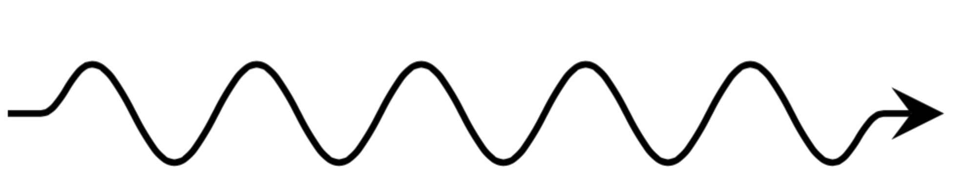
Attention – Influence Point Of View
Attention encodes how much influence the context u has on x
v
u
w
x
Typically x and context vectors are first projected through a learnable matrix W
Question Answering over Curated and Open Web Sources R. Saha Roy and A. Anand SIGIR 2020 Tutorial
26 July 2020
Notes:
x^\prime = \underbrace{\left( \frac{e^{x.u}}{e^{x.u} + e^{x.v} + e^{x.w}} \right)}_{\alpha_u} u + \underbrace{\left( \frac{e^{x.v}}{e^{x.u} + e^{x.v} + e^{x.w}} \right)}_{\alpha_v} v + \underbrace{\left( \frac{e^{x.w}}{e^{x.u} + e^{x.v} + e^{x.w}} \right)}_{\alpha_w} w

Slide 11
Attention Mechanism – Memory Point Of View
Attention retrieves values from a continuous memory using fuzzy matching
Key
Values
Assume vectors are stored in memory referenced by Key matrix K
Thought expt: for 1-hot vectors = hashmaps
Instead Kx retrieves from this continuous memory as a weighted sum over all values
v
K
v
V
x
K
w
K
w
V
u
K
u
V
Attention weight
Question Answering over Curated and Open Web Sources R. Saha Roy and A. Anand SIGIR 2020 Tutorial
26 July 2020
Notes:
x^\prime = \underbrace{\left( \frac{e^{x.u}}{e^{x.u} + e^{x.v} + e^{x.w}} \right)}_{\alpha_u} u + \underbrace{\left( \frac{e^{x.v}}{e^{x.u} + e^{x.v} + e^{x.w}} \right)}_{\alpha_v} v + \underbrace{\left( \frac{e^{x.w}}{e^{x.u} + e^{x.v} + e^{x.w}} \right)}_{\alpha_w} w

Slide 12
Attentive Reader
[Chen ‘16] Attentive reader
Tokens
Word embeddings
Exact matching features
POS,NEF, TF features
Alignment
Passage
Bi-LSTM
Query-Passage Interaction
Soft Attention
Answer Gen.
Span Pred.
Question Answering over Curated and Open Web Sources R. Saha Roy and A. Anand SIGIR 2020 Tutorial
26 July 2020

Slide 13
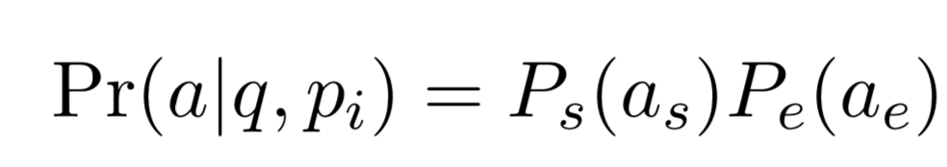
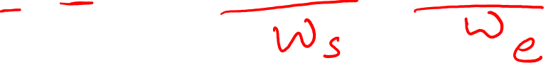
Attentive Reader
[Chen ‘16]
Question Answering over Curated and Open Web Sources R. Saha Roy and A. Anand SIGIR 2020 Tutorial
26 July 2020

Slide 14
Input Representation
DrQA [Chen ‘17]
Context words are represented based on similarity with the query
Semantic similarity
Word embeddings
Matching similarity
Direct word-level matching
Weighted matching
Attention mechanism
Answer Prediction
Context
Question
Embedding-based representation
Query-based representation
Question Answering over Curated and Open Web Sources R. Saha Roy and A. Anand SIGIR 2020 Tutorial
26 July 2020

Slide 15
Late Interaction
MatchLSTM [Wang & Jiang ‘16], DCN [Xiong ‘16], BiDAF [Seo ‘17]
First encode question and context sufficiently
Choice of encoders
Bi-LSTMs
Conv Nets
Most popular Model
Bi-directional attention flow [Seo ‘17]
Answer Prediction
Context
Question
Question Answering over Curated and Open Web Sources R. Saha Roy and A. Anand SIGIR 2020 Tutorial
26 July 2020

Slide 16
Other Variants
Rasor [Lee ‘16], fastQA [Weissenborn’17]
Answer Prediction
Answer Prediction
Early Interaction
Self Matching
Context
Question
Context
Question
Question Answering over Curated and Open Web Sources R. Saha Roy and A. Anand SIGIR 2020 Tutorial
26 July 2020

Slide 17
Attention Based Architectures
2016 – 2017 – Multitude of attention based architecture
Question Answering over Curated and Open Web Sources R. Saha Roy and A. Anand SIGIR 2020 Tutorial
26 July 2020

Slide 18
Contextual Language Models
[Devlin ‘18]
BERT – No Recurrence, only attention
Re-representing each token based on the context
Shows the most promising performance
Answer Prediction
Transformer block
.
.
.
Transformer block
Transformer block
Context
Question
Question Answering over Curated and Open Web Sources R. Saha Roy and A. Anand SIGIR 2020 Tutorial
26 July 2020

Slide 19
BERT
Bi-directional : Transformer encoder reads the entire sequence of words at once.
Learns the context of a word based on all of its surroundings (left and right of the word).
Question Answering over Curated and Open Web Sources R. Saha Roy and A. Anand SIGIR 2020 Tutorial
26 July 2020

Slide 20
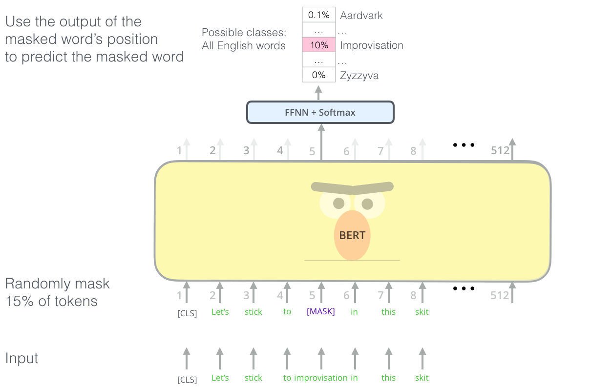
BERT– Masked Language Model
Masked word prediction
Given a sentence with some words masked at random, can we predict them?
Randomly select 15% of tokens to be replaced with “<MASK>”
Question Answering over Curated and Open Web Sources R. Saha Roy and A. Anand SIGIR 2020 Tutorial
26 July 2020
Notes:
The real power of BERT comes from its unsupervised pre-training regime

Slide 21
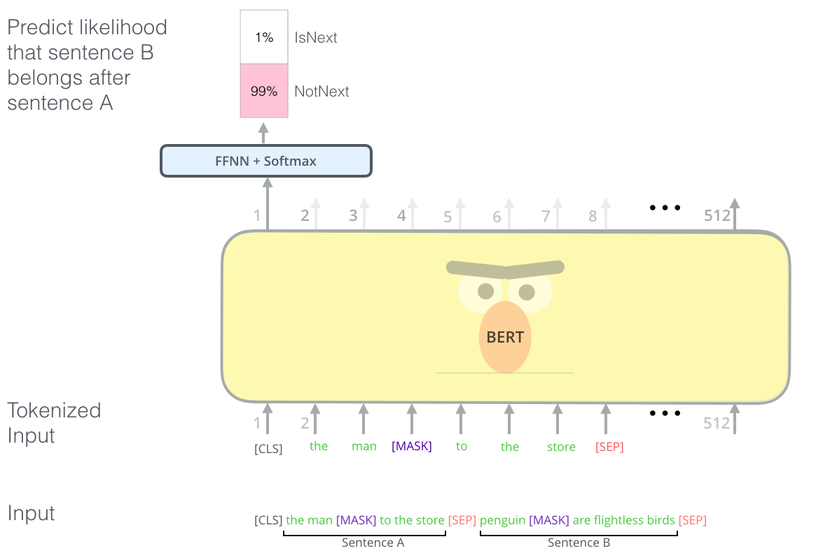
Next Sentence Prediction
Given two sentences, does the first follow the second? Teaches BERT about relationship between two sentences
50% of the time the actual next sentence, 50% random
Question Answering over Curated and Open Web Sources R. Saha Roy and A. Anand SIGIR 2020 Tutorial
26 July 2020
21

Slide 22
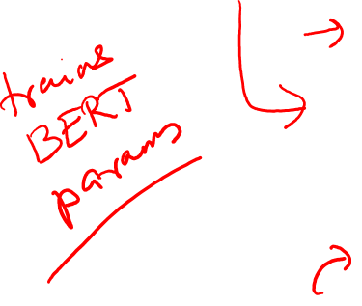
BERT Fine Tuning
Inputs to BERT – [CLS] <token embeddings> [SEP] …
Classification tasks such as sentiment analysis are done similarly to Next Sentence classification, by adding a classification layer on top of the Transformer output for the [CLS] token.
Single sentence input
Single sentence input
Question Answering over Curated and Open Web Sources R. Saha Roy and A. Anand SIGIR 2020 Tutorial
26 July 2020

Slide 23
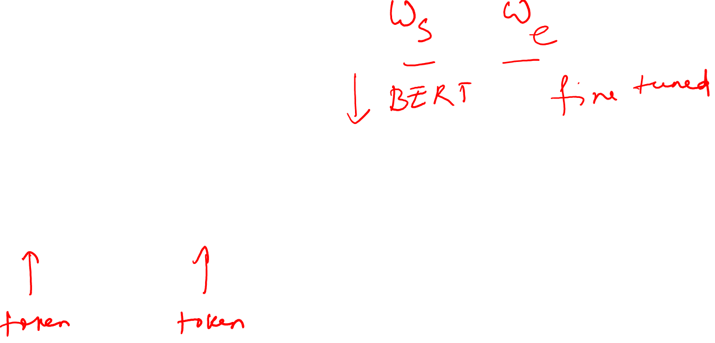
BERT Fine Tuning
Q&A model can be trained by learning two extra vectors that mark the beginning and the end of the answer.
Question Answering over Curated and Open Web Sources R. Saha Roy and A. Anand SIGIR 2020 Tutorial
26 July 2020

